Slide 1
EXCEL FUNCTIONS
OfficeNewb.com

Slide 2
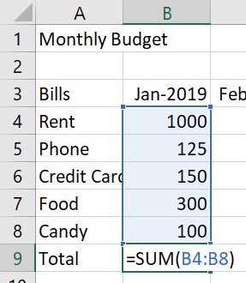
Excel Function: A predefined formula that performs a calculation
=SUM(B4:B8)

Slide 3

Building Blocks of Excel Functions
3 Parts of an Excel Function
=
FUNCTION NAME
(ARGUMENTS)

Slide 4
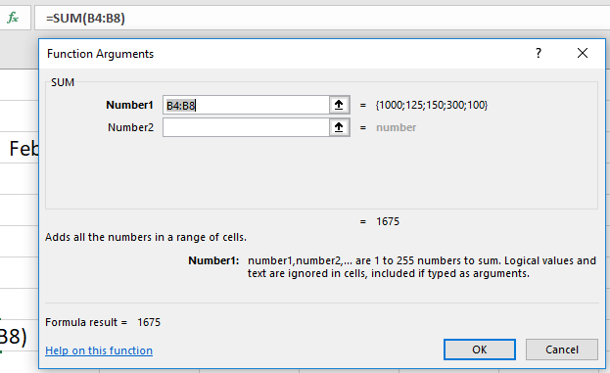
Function Arguments Window

Slide 5
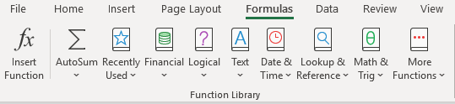
Excel Functions

